Slide 1
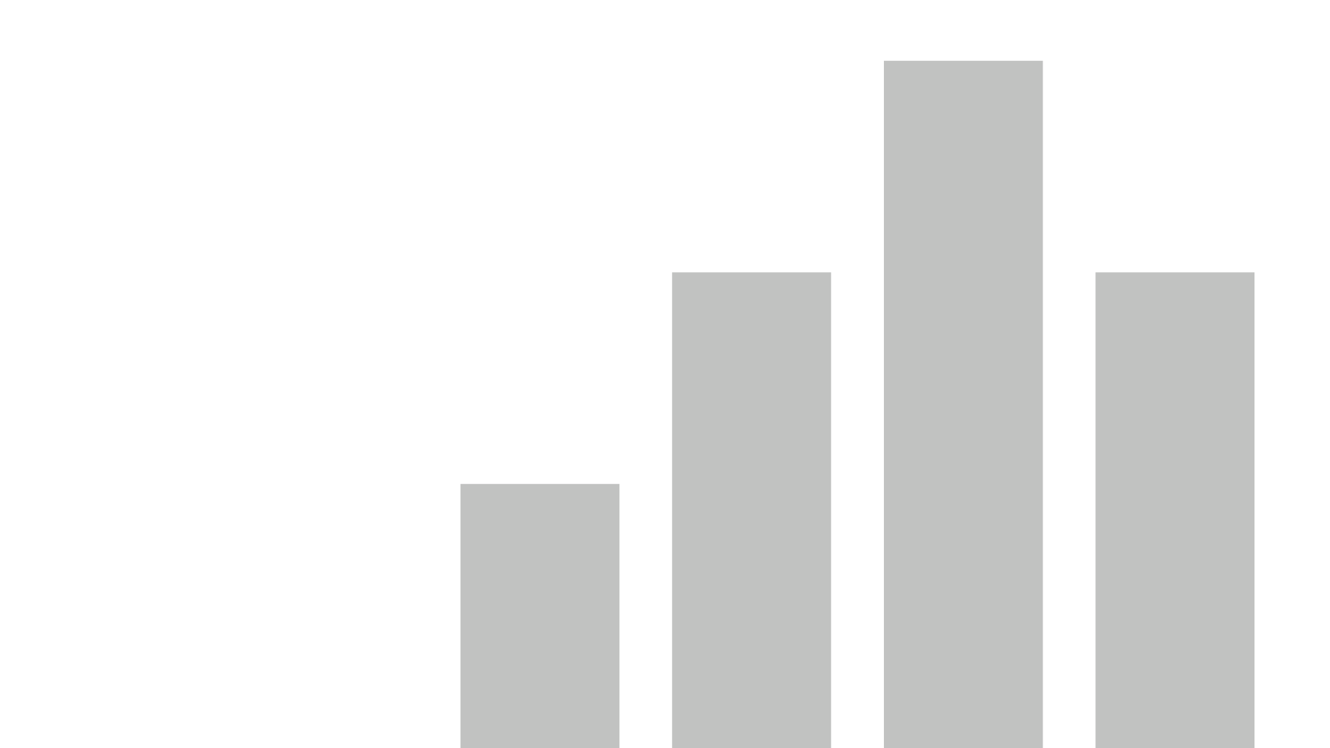

Capstone One: Comparative Algorithmic Trading Analysis
Date: 3.15.2020
Created By: Derek Strang

Slide 2
Investor sentiment has demonstrated a desire to maximize returns over the next calendar year through investing in large cap companies with high risk/high reward growth potential. Consequently, our fund manager has requested an aggressive portfolio of 4 or 5 handpicked large cap companies from the DOW Jones industrial average that have a demonstrated history of large growth and to apply an algorithmic trading strategy to maximize the returns and hedge losses.
SMART PROBLEM STATEMENT
How can a small mutual fund, Capital Investments, implement algorithmic trading strategies ​
that use either a 10/20 day moving average mean reversion or a triangular moving average to maximize​
returns for it’s investors over the next calendar year?​
STATISTICAL APPROACH #1: Use descriptive statistics to develop a tabular and graphical view of the data to gain insights into the industries and companies in the Dow Jones that have the highest historical growth in order to identify the selection of 4 or 5 handpicked large cap stocks to perform a comparative algorithmic analysis on.
STATISTICAL APPROACH #2: Implement technical analysis procedures to handpicks stocks such as 10, 20 and triangular moving averages from which both algorithmic trading strategies, both mean reversion and triangular moving average, can be applied and tested to see which perform best over the last year’s market conditions.

Slide 3
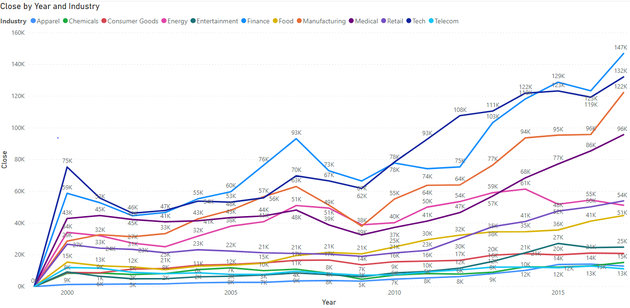
Through a descriptive statistical approach, all industry categories where visualized in a time series from the year 2000 through December of 2017, from which industries with the highest cumulative close price growth over the period were identified.
Key Insights
From the year 2000 through December of 2017, we see the steepest growth in the finance, tech, and manufacturing industries, where we saw a _,_ and _ percent increase in cumulative close price respectively….
Over the same period, we saw the least amount of growth in chemicals, telecom and apparel.
Given our Investors have expressed a desire to invest in large cap companies with greater earning potential over the next year, our team has focused on investigating stocks within the index that are either from finance, tech and manufacturing.

Slide 4
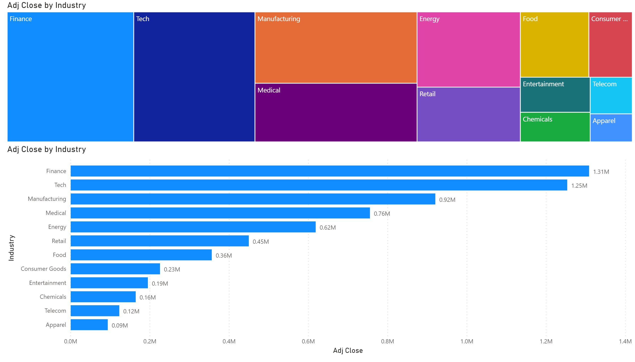
By representing the industry data through bar chart visualizations, a cumulative total of daily close prices further illustrates the industries that have historically traded at higher prices within the Dow Jones index.
Key Insights
Like our previous slide, we see finance, tech and manufacturing representing the top 3 industries in terms of cumulative daily close price for the period between 2000 and December of 2017.
Similarly, we see chemicals. Telecom and apparel representing the bottom three industries in terms of cumulative daily close price for the same period.
Finance, tech, and manufacturing represent 54% of the index’s entire cumulative daily close price for the period between 2000 and December of 2017. Conversely, chemicals, telecom and apparel only represent 6% of the index’s entire cumulative dailyl close price for the same period.

Slide 5
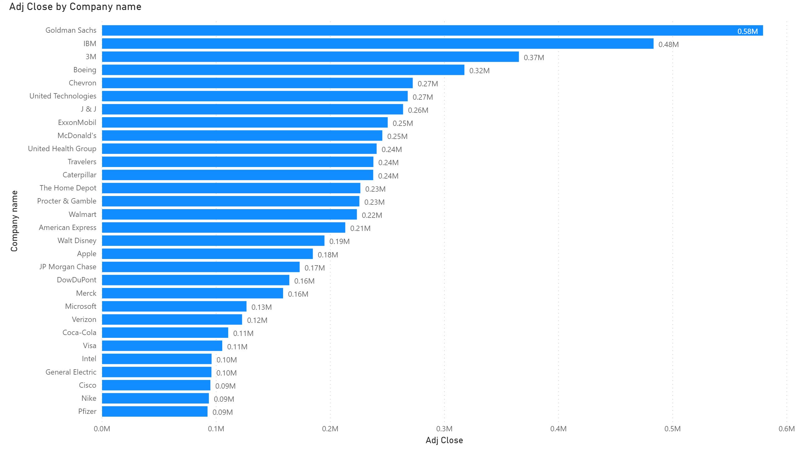
Through a more granular view into the industry level bar chart data, an additional view of the data containing the cumulative daily close price per company within the Dow Jones index can be visualized in order to identify the companies that have historically traded at higher prices.
Key Insights
Much like our barchart data representing the cumulative close price by industry, here we see the top 4 companies represented by finance, tech, and manufacturing stocks, with Goldman accounting for .58M, IBM for .48M, 3M for .37M and Boeing for .32M.
These 4 Stocks represent 27% of the index’s entire cumulative daily close price for the 18 year period.

Slide 6
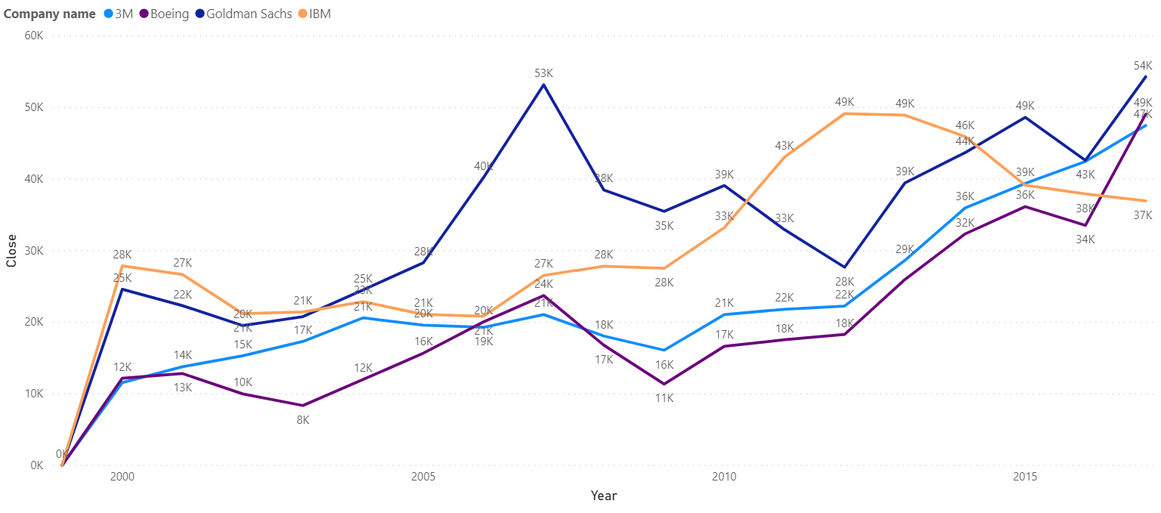
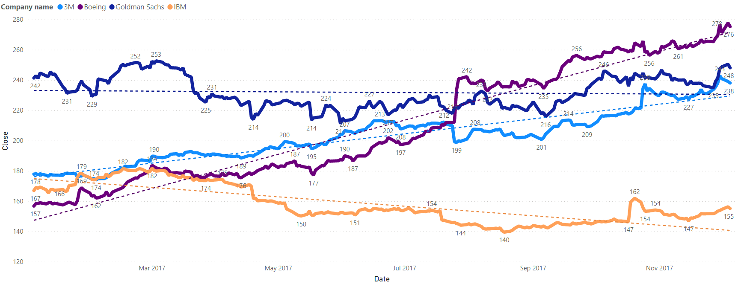
Through a comparative analysis of our 4 chosen stock choices using the cumulative close price per year for years 2000 to 2017 versus a more granular view of the daily close price per day for all current data for 2017 reflects the long term trend of each stock versus the more recent activity of the respective stocks.
Key Insights
For the period of 2000 through December of 2017, we see strong growth from all 4 stocks, with Boeing showing the largest growth at 76%, followed by 3M at 74%, Goldman Sachs at 54% and IBM with 32% growth.
The short term trends for all data collected over 2017, illustrated below, shows a similar picture with Boeing demonstrating the most growth of 76%, with Goldman and 3M pretty flat at 3% and 2% growth respectively. Finally, IBM saw losses over the last year with an 11% decrease in stock price over the last year.

Slide 7
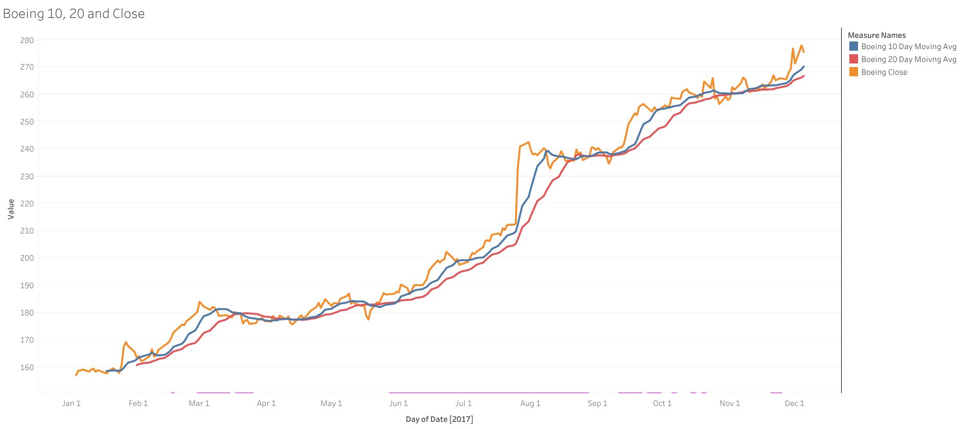
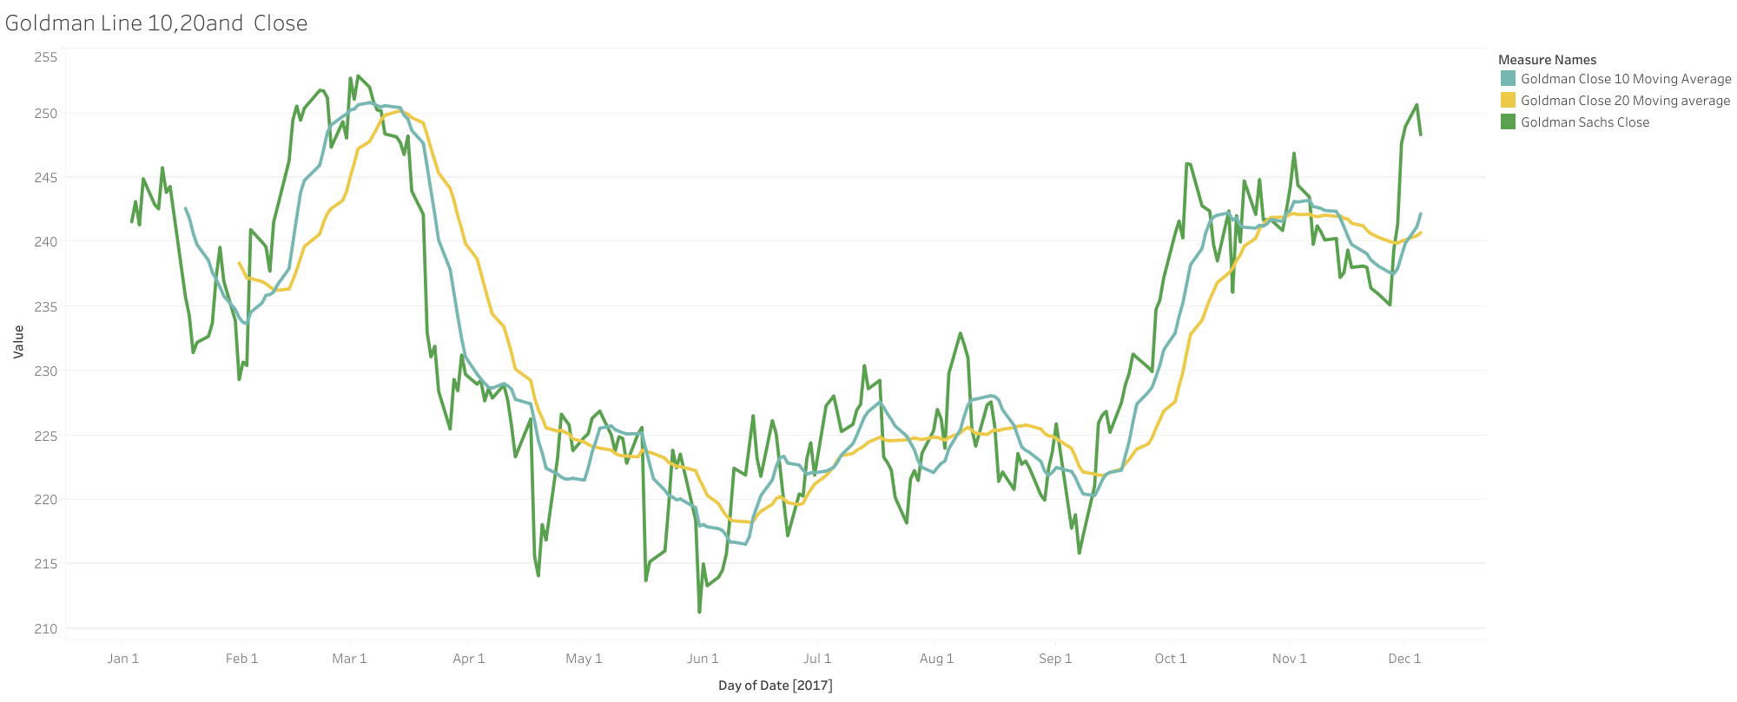
The first algorithmic trading strategy that was employed implements the use of a 10, and 20 day moving average to predict the movement of each stock’s respective close price. Using the 10 and 20 day moving averages of each stock, an algorithm using a simple conditional if statement was used to buy when the stocks were increasing sell when they decrease. The algorithm is as follows: IF 10 Day Moving Avg >= 20 Day Moving Avg, buy, Otherwise, Sell
Key Insights
The application of the algorithm above on both the Boeing and Goldman saw respective returns of 51%, and -6% respectively over the 2017 calendar year.
Conversely, if Boeing and Goldman stocks were simply bought and held for the 2017 calendar year, respective returns of 76% and 3% returns would have been realized.

Slide 8
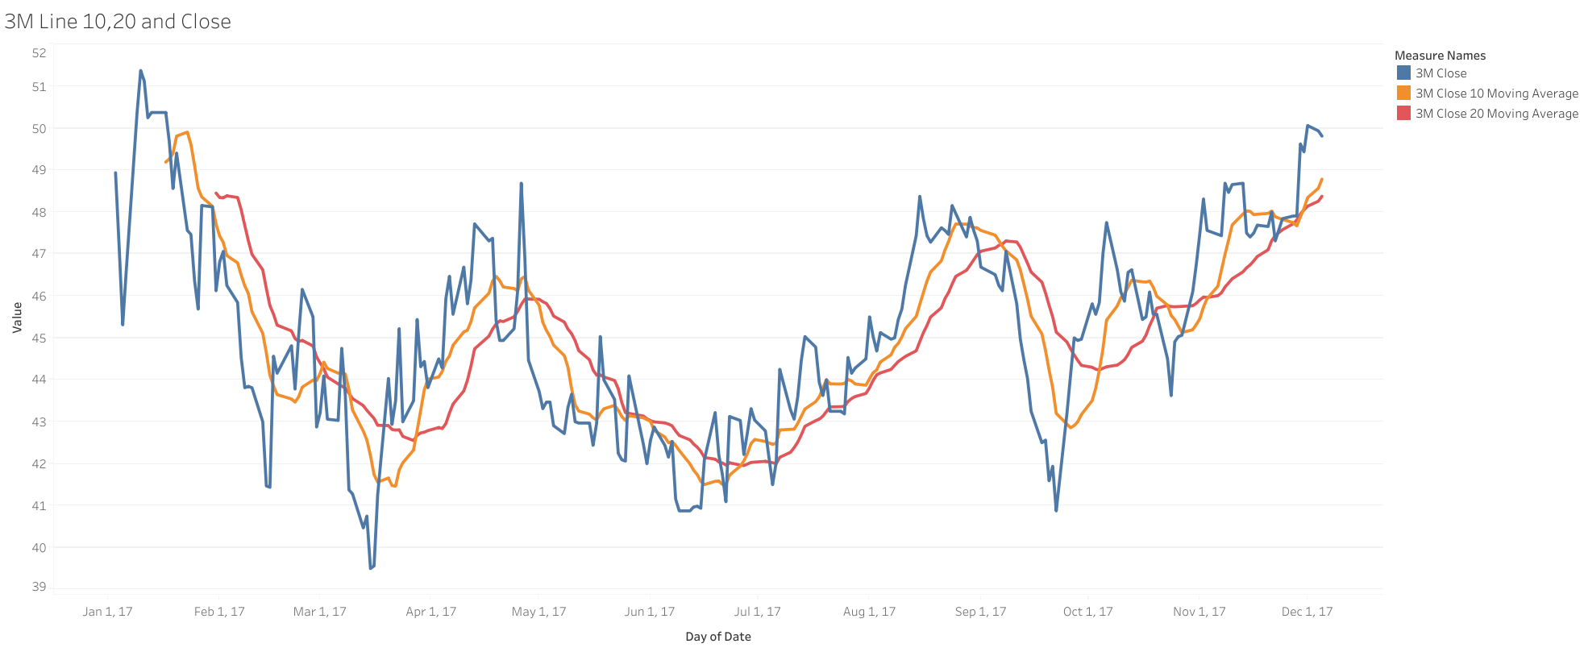
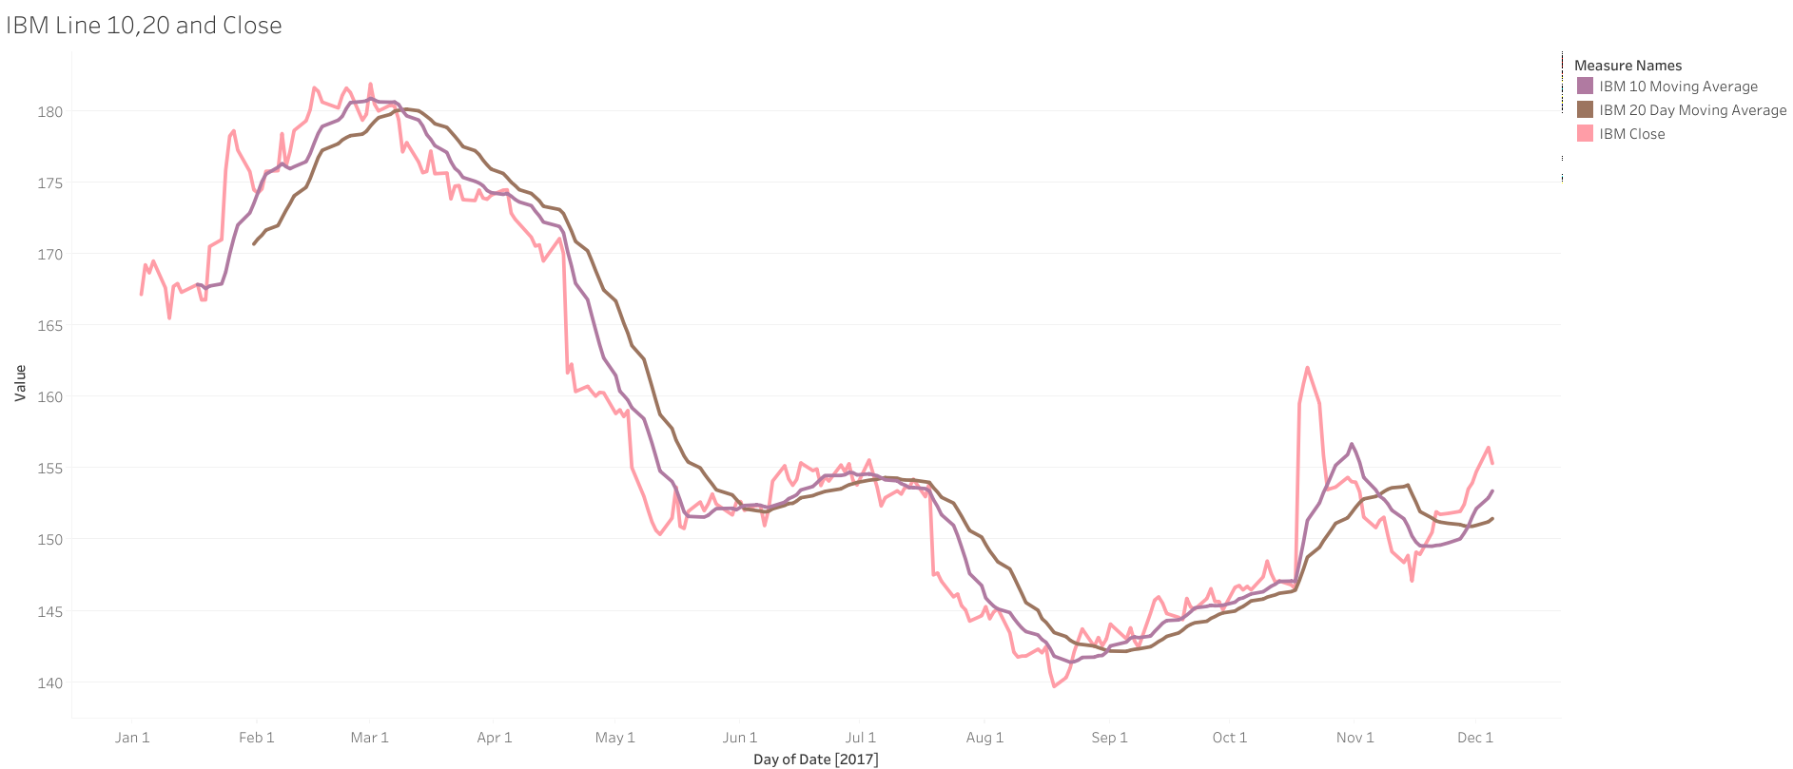
Key Insights
Applying the same algorithm implementing the 10 and 20 day moving average from the previous slide, we saw 1% returns from 3M and 14% returns from IBM.
Conversely, if bought and held over the 2017 period, 3M would have seen 2% returns and IBM would have seen a loss of 11% of it’s stock price.
SUMARIZE DIFFERENCES FROM ABOVE In summation, the algorithm using 10 and 20 day moving averages produced 59% returns collectively, representing a -10% difference from the 69% returns produced if the same stocks were bought and held.

Slide 9
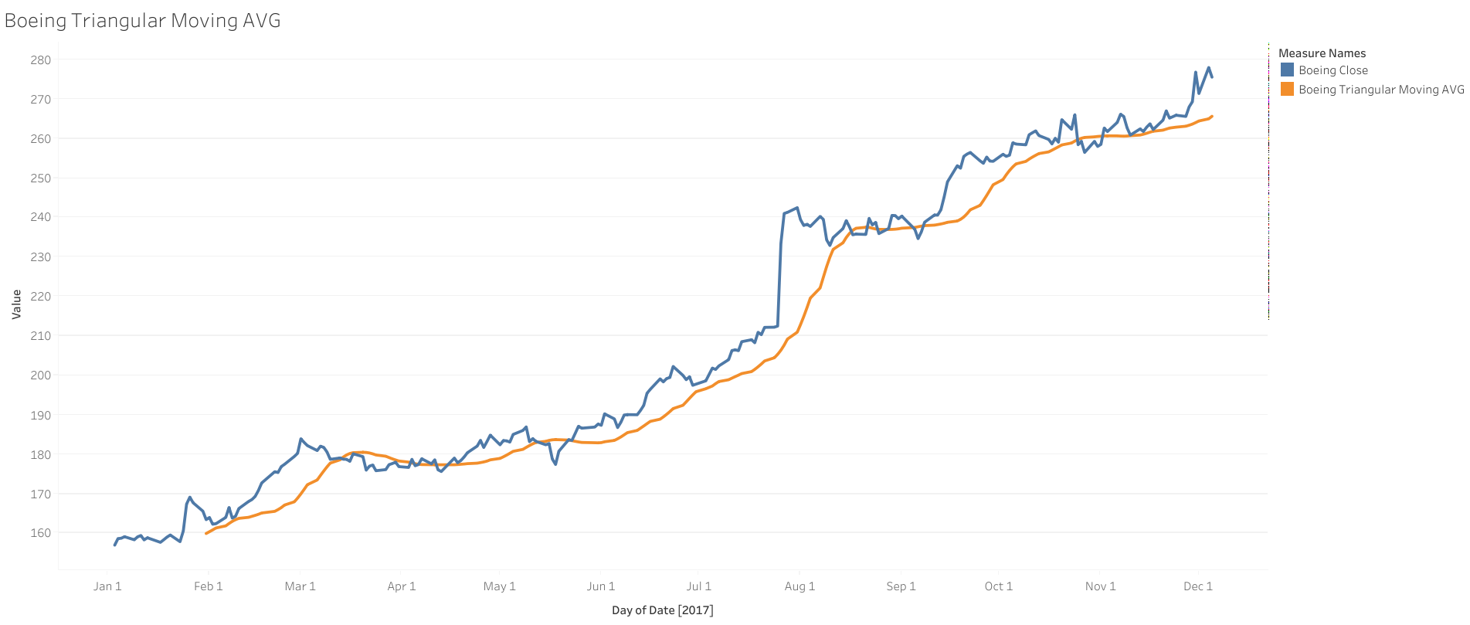
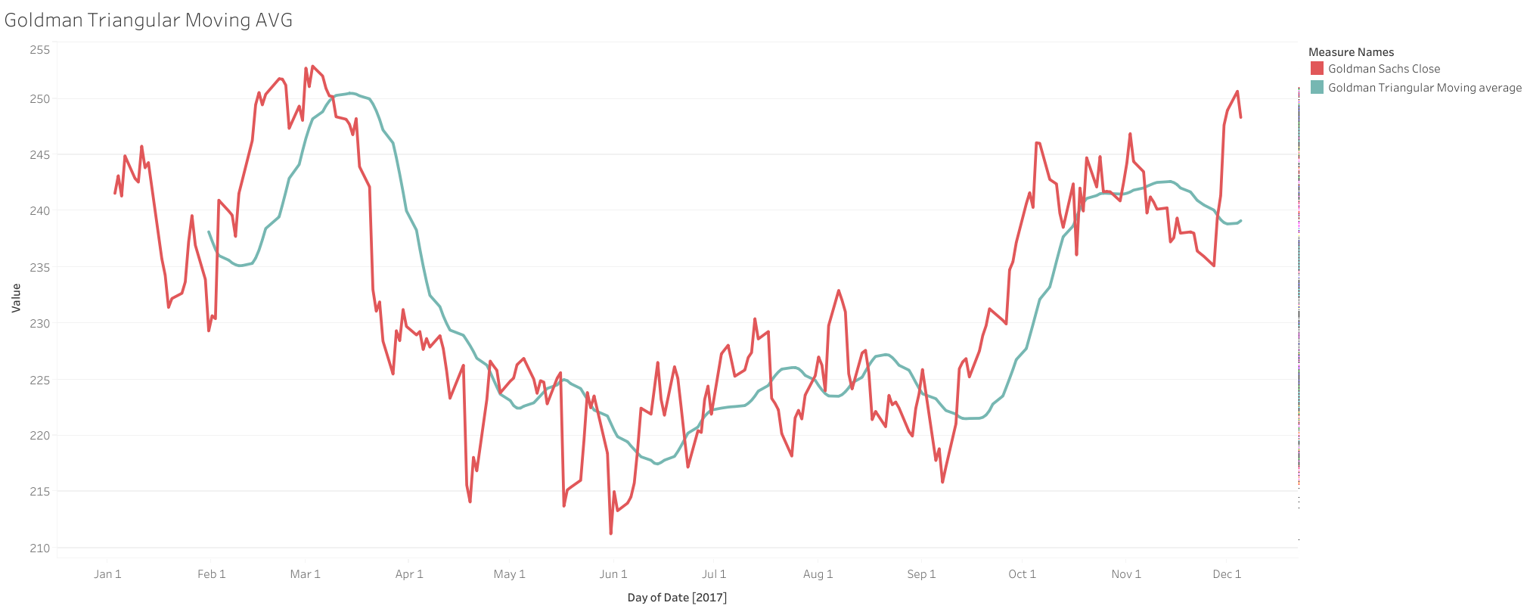
The second algorithm that was tested uses a triangular moving average to predict the movement of the close price. The triangular moving average is a composite that takes in the moving average of a specified preceding timeframe and takes a moving average for the future period of the same length. This algorithm is as follows: IF Triangular Moving AVG <= Close Price, Buy, Otherwise SELL
Key Insights
When applied to Boeing and Goldman, the triangular Moving average algorithm was respective returns of 64% and 41%.
Conversely, if held, the same Boeing would have seen returns of 76% and Goldman would have seen returns of only 3% for the 2017 calendar year.

Slide 10
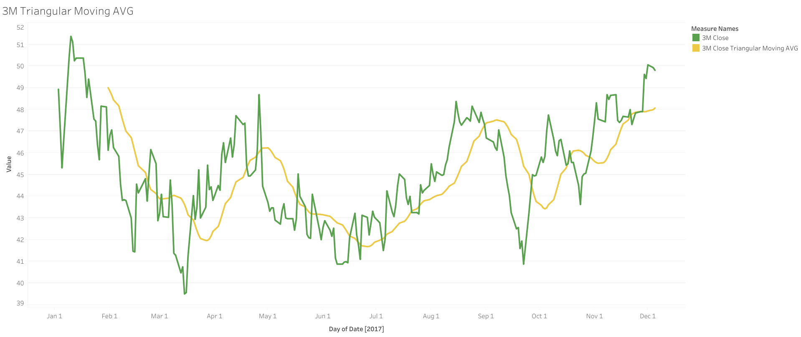
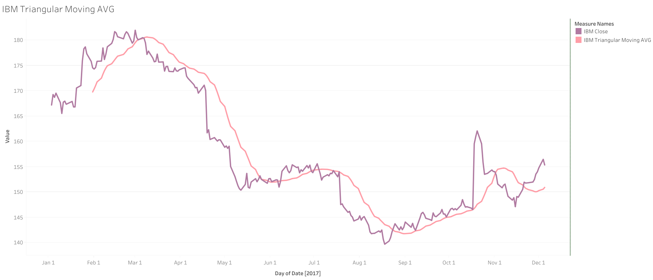
Key Insights
Our triangular moving average had a high performance with both 3M and IBM as well, with 3M seeing 64% returns with this strategy, while IBM saw a 20% increase in it’s stock’s close price in 2017.
Overall, our triangular moving average algorithm performed the best when tested against the most recent calendar year of 2017, producing a staggering cumulative increase in stock price of 188%, as compared to 69% if held and 59% if employed the strategy around the 10 and 20 day moving averages.
Conclusion
In summation, the triangular moving average algorithm performed a 118% than if held versus the 10 and 20 day moving average algorithm, which performed -10% below.
 | 10/20 Moving Avg Algorithm Returns | Triangular Moving Avg Algorithm Returns | If Held | 10/20 Difference | Tria Difference
Boeing | 51% | 64% | 76% | -25% | -12%
Goldman | -6% | 41% | 3% | -9% | 38%
3M | 1% | 64% | 2% | -1% | 62%
IBM | 14% | 20% | -11% | 25% | 31%
Net Total | 59% | 188% | 69% | -10% | 119%

